Slide 1
DIGITAL SIGNAL PROCESSING MINI-PROJECT

Slide 2
IMAGE ENHACEMENT
JACOB J PANICKER
EE21B021

Slide 3
TABLE OF CONTENTS
01
02
03
04
05
06
INTRODUCTION
THEORY
CODE
EXTRAS
DEMO
REFERENCES

Slide 4
01
INTRODUCTION

Slide 5
IMAGE ENHANCEMENT
Image enhancement typically refers to the process of improving the visual quality of an image. There are various techniques and tools available for image enhancement, and the choice of method depends on the specific goals and characteristics of the image.
Below are few of the techniques/methods:-
Brightness and Contrast Adjustment
Color Correction
Sharpness Enhancement
Noise Reduction
Image Resizing
Histogram Equalization
Saturation Adjustment
HDR (High Dynamic Range)
Image Filtering
Dehazing
In this mini-project, we’ll be focusing on the noise reduction aspect, as well as grazing over the other techniques, by using filters and implementing a code in Python using Python libraries.

Slide 6
FACTS ABOUT THE TECHNIQUES
Brightness and Contrast Adjustment
Adjust the brightness or contrast of an image
Color Correction
Balancing the correct to correct any color cast
Sharpness Enhancement
Enhances the edges and details in the image
Noise Reduction
Removing unwanted noise signals in the image
Image Resizing
Resizing an image while maintaining the same quality
Histogram Equalization
Spreads out the pixel intensities in an image to cover the entire range
Saturation Adjustment
Adjusting the saturation of colors in the image, controlling the vividness
HDR (High Dynamic Range)
Capturing a wider range of tones/multiple exposures of the same scene
Image Filtering
Blur, vignette, sepia filters or effect addition
Dehazing
Reducing the impact of atmospheric haze in outdoor photos

Slide 7
02
THEORY

Slide 8
NOISE REDUCTION
Unwanted changes in pixel values that do not belong in the scene are called noise in pictures. Sensor limitations, transmission interference, and environmental factors are among the causes of image noise. Improving an image's quality and sharpness by reducing or eliminating these undesired changes is what noise reduction is all about.
There can be different types of noises, but in terms of being more studied upon, there are broadly two:-
Gaussian Noise: This type of noise is characterized by random variations that follow a Gaussian (normal) distribution. It appears as random speckles and can affect both the brightness and color of individual pixels.
Salt and Pepper Noise: This type of noise introduces random occurrences of very bright (salt) or very dark (pepper) pixels. It simulates the appearance of random, isolated outliers in the image.

Slide 9
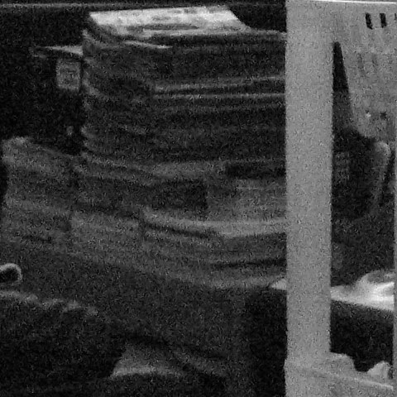
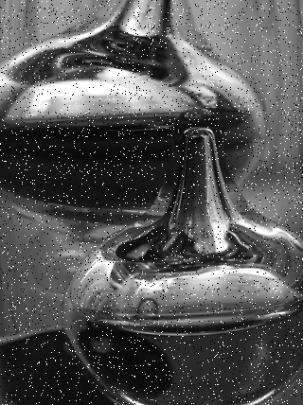
Examples for noisy images

Slide 10
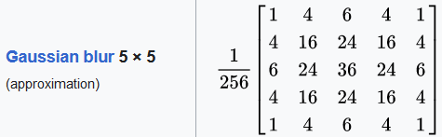
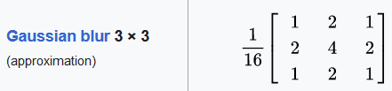
NOISE REDUCTION
The objective of noise reduction techniques is to maintain the key elements of a picture while simultaneously smoothing out or filtering out the changes that are not desired.
Mentioned below are two techniques:-
Gaussian Blur: This method involves applying a convolution operation with a Gaussian kernel to the image. The convolution blurs the image, reducing high-frequency noise while preserving the overall structure. The size of the Gaussian kernel determines the extent of smoothing.
Median Filtering: This method replaces each pixel value with the median value in its neighborhood. Median filtering is particularly effective at removing salt and pepper noise, as it replaces outliers with more typical pixel values.

Slide 11
MATHEMATICAL ANALYSIS
Generally, an image is considered as a matrix arrangement of pixels, so each pixel has co-ordinates of the form (row number, column number). Depending on the image, it can have more than one channels. A channel refers to a grayscale image component representing the intensity of light for a specific color. In a standard color image, we often have three channels corresponding to the primary colors: red, green, and blue. In this project, we’ll be focusing on images with only one channel, i.e., greyscale images.
Each pixels has a value which can range from 0 to 255, where these values indicate the intensity of a pixel, so 0 indicates minimum intensity (black) and 255 indicates maximum intensity (white).
In order to make variations to the values of these pixels, we make use of a function which is called the kernel. A kernel, convolution matrix, or mask is a small matrix used for blurring, sharpening, embossing, edge detection, and more. This is accomplished by doing a convolution between the kernel and an image.
Convolution is a mathematical operation on two functions that produces a third function that expresses how the shape of one is modified by the other. It is the process of adding each element of the image to its local neighbors, weighted by the kernel.

Slide 12
MATHEMATICAL ANALYSIS
When doing the convolution, the kernel is to be placed on top of the convolution matrix such that the center element of the kernel coincides with the pixel of the image which we want to undergo the change. When doing so, a problem may arise, due to the fact that the kernel might go out of bounds of the image. In such cases, edge handling is done. Some of them are noted below:-
Extend: The nearest border pixels are conceptually extended as far as necessary to provide values for the convolution. Corner pixels are extended in 90° wedges. Other edge pixels are extended in lines.
Wrap: The image is conceptually wrapped (or tiled) and values are taken from the opposite edge or corner.
Mirror: The image is conceptually mirrored at the edges. For example, attempting to read a pixel 3 units outside an edge reads one 3 units inside the edge instead.
Constant: Use constant value for pixels outside of image. Usually black or sometimes gray is used. Generally this depends on application.
For simplicity, the technique used in this project is the constant edge handling, padding with zeroes.

Slide 13
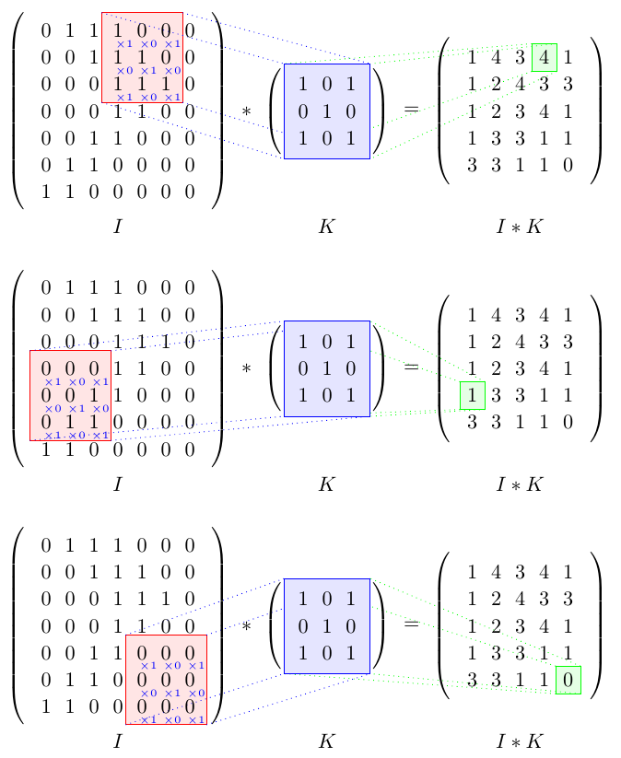

MATHEMATICAL ANALYSIS

Slide 14
03
CODE

Slide 15
LIBRARIES USED
Language used: Python
numpy
matplotlib
matplotlib.pyplot
cv2
math

Slide 16
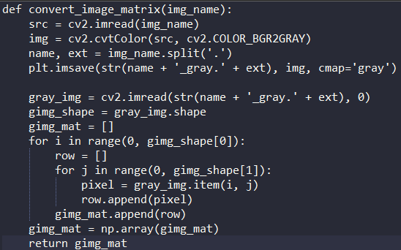
1.CONVERTING TO GREYSCALE
The input picture is first gray-scaled and then transformed into a pixel matrix where each pixel's value ranges from 0 to 255 representing the intensity of that pixel at that location.
However, the conversion is only necessary for color photos and those pictures already in the grayscale mode can be directly converted into the image matrix.

Slide 17
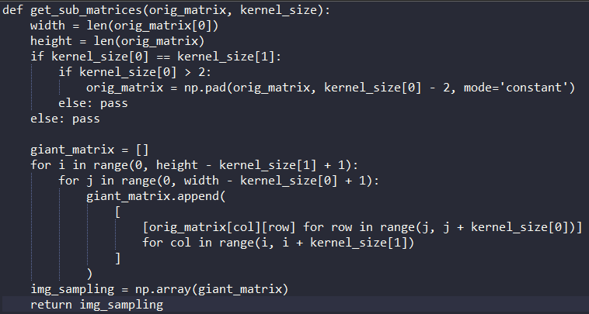
2.EDGE HANDLING
Just as discussed before, the problem of edge handling arises in this situation.
The amount of edge handling required also depends on the kernel size, so care must be taken there too. Most of the kernels are of the size 3, but size 5 also exists.
(Size N means NxN matrix)
At the end of this stage, we’ll get an output matrix which is then further used for convolution with the kernel function.

Slide 18
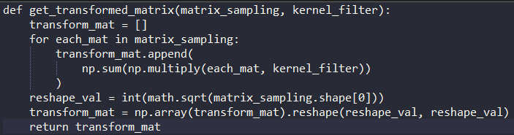
3.CONVOLUTION
Convolution of the image matrix with the kernel matrix. Note that the orientation of the kernel with respect to the transformed image matrix should be like what was discussed earlier. (Slide 12)

Slide 19
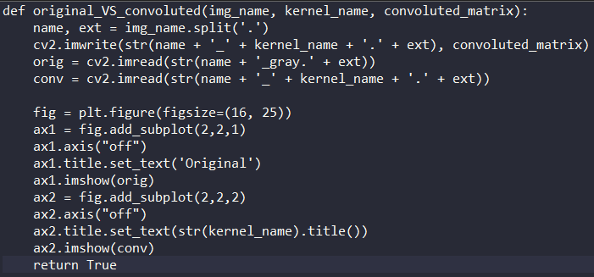
4. FINAL OUTPUT
The final segment deals with the comparison of the original or grayscale version of the input picture with its final filtered output. The final and the grayscale image will be saved in the directory the program was saved in.

Slide 20
04
EXTRAS

Slide 21
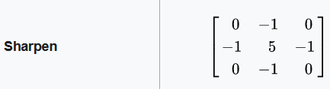
SHARPENING
Digital photographs may be enhanced using a technique called image sharpening to make them seem more detailed. The process of sharpening makes an image's edges stand out more. Images with low quality at the margins are drab. Background and edges are almost indistinguishable. In contrast, a sharpened picture is one where the viewer can make out the edges.

Slide 22
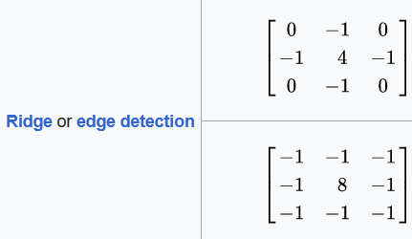
IMAGE EDGE DETECTION
By using edge detection, viewers are able to scrutinize an image's characteristics for a notable shift in grayscale. With this texture, we can see where one area of the picture ends and another begins. It maintains a picture's structural integrity while decreasing the quantity of data in the image. This is a popular technique for deep learning feature extraction from images.

Slide 23
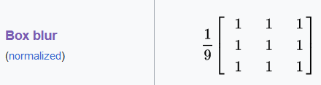
BOX BLUR
Computer graphics and image processing often make use of box blur, a straightforward method for blurring images. In it, inside a predetermined rectangular region called the "box," the average color value of each pixel is calculated by adding up the values of all the pixels immediately around it. The method softens and reduces the appearance of distinct characteristics by reducing high-frequency noise and smoothing out small details. The blur effect is proportional to the box's size; bigger boxes result in more noticeable blurring. Since it doesn't need a lot of processing power, box blur is a go-to for real-time uses like video games and editing multimedia, where simple and fast blurring is needed.

Slide 24
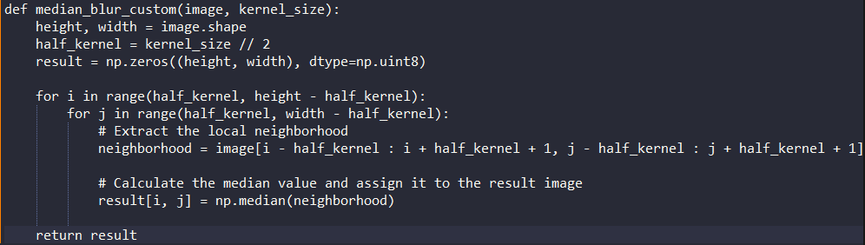
MEDIAN BLUR CODE
As discussed before, there are kernels for each purpose such as sharpening, blurring and edge detection, but median blur doesn’t. Instead, it follows a mathematical procedure.
Median blur includes taking the average value of the neighboring pixel intensities and replaces the pixel which is getting interfered by the noise. This is very much effective against salt and pepper noise.

Slide 25
05
DEMOS

Slide 26

GAUSSIAN BLUR
Original Image
Image after Gaussian Blur

Slide 27

BOX BLUR
Original Image
Image after Box Blur

Slide 28

MEDIAN BLUR
Original Image
Image after Median Blur

Slide 29

MEDIAN BLUR
Original Image
Image after Median Blur

Slide 30
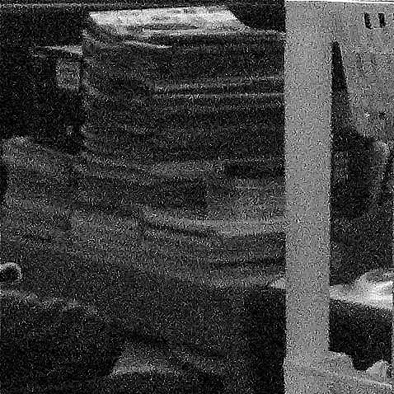
SHARPENING
Original Image
Image after Sharpening

Slide 31

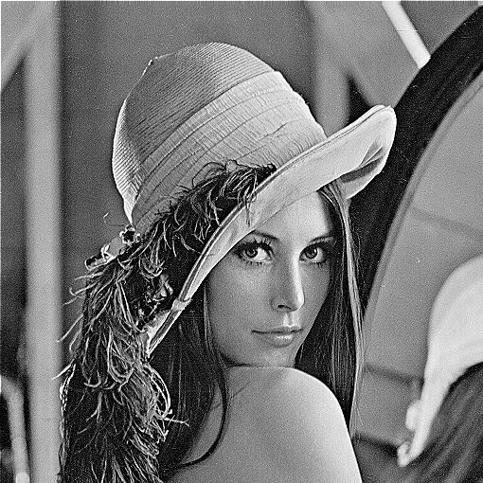
SHARPENING
Original Image
Image after Sharpening

Slide 32
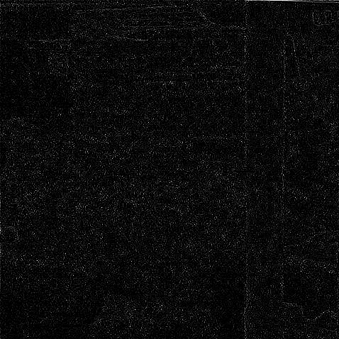
EDGE DETECTION
Original Image
Image after Edge Detection

Slide 33
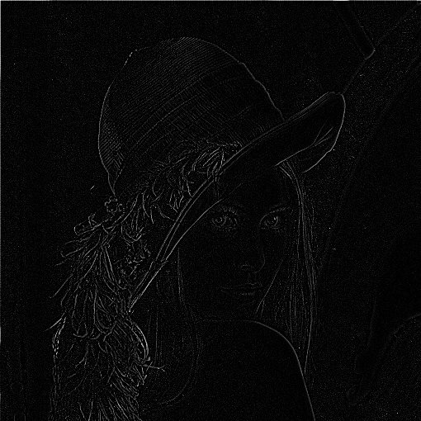
EDGE DETECTION
Original Image
Image after Edge Detection

Slide 34
06
REFERENCES

Slide 35
REFERENCES
MATLAB Documentation
Library file documentations
Numpy
OpenCV
Matplotlib
GeeksforGeeks
The Medium
Wikipedia articles
ScienceDirect

Slide 36
THANKS!

Slide 37
Fonts & colors used
This presentation has been made using the following fonts:
Lexend
(https://fonts.google.com/specimen/Lexend)
Space Grotesk
(https://fonts.google.com/specimen/Space+Grotesk)
#191919
#f0efef
#ffffff
#4619bb
#20124d

Slide 38


